Slide 1
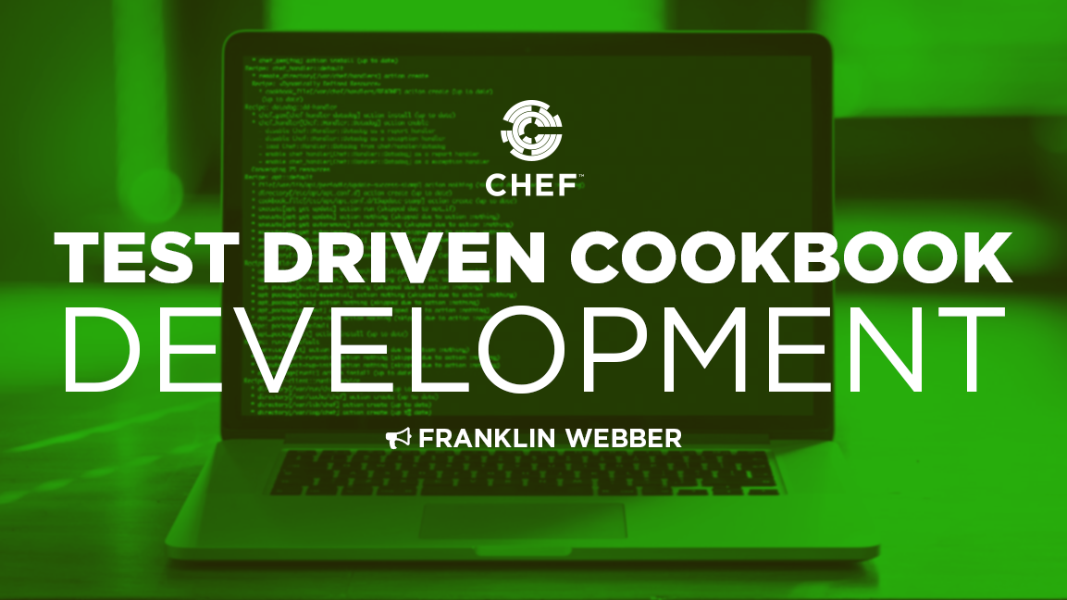
Test Driven Cookbook Development
2017
Notes:
Welcome to Test Driven Cookbook Development.

Slide 2

Franklin Webber
Training and Technical Content Lead
US Army - Radio/COMSEC Repairer (35E)
Tech Support
Quality Assurance
Software Developer Eng. in Test
Software Developer
Instructor / Trainer
Notes:
Before we start let me introduce myself.

Slide 3
You are...
Notes:
By scientific I am saying you are someone that believes in the scientific method.
Ask a Question
Test with an Experiment
Analyze Data and Communicate Result

Slide 4
You are...
interested in learning more about Chef
Notes:
By scientific I am saying you are someone that believes in the scientific method.
Ask a Question
Test with an Experiment
Analyze Data and Communicate Result

Slide 5
You are...
interested in learning more about Chef
1
Define a question
written a recipe in a cookbook
Test the hypothesis
2
3
Analyze Data
4
Communicate Result
Notes:
I liked the highlighted steps and thought I could use them elsewhere. Otherwise delete it.

Slide 6
You are...
interested in learning more about Chef
written a recipe in a cookbook
Notes:
By scientific I am saying you are someone that believes in the scientific method.
Ask a Question
Test with an Experiment
Analyze Data and Communicate Result

Slide 7
You are...
interested in learning more about Chef
written a recipe in a cookbook
interest in testing
Notes:
By scientific I am saying you are someone that believes in the scientific method.
Ask a Question
Test with an Experiment
Analyze Data and Communicate Result

Slide 8
You are...
interested in learning more about Chef
written a recipe in a cookbook
interest in testing
belief in the scientific method
Notes:
By scientific I am saying you are someone that believes in the scientific method.
Ask a Question
Test with an Experiment
Analyze Data and Communicate Result

Slide 9
You are...
interested in learning more about Chef
written a recipe in a cookbook
interest in testing
belief in the scientific method
Notes:
By scientific I am saying you are someone that believes in the scientific method.
Ask a Question
Test with an Experiment
Analyze Data and Communicate Result

Slide 10
You are...
interested in learning more about Chef
written a recipe in a cookbook
interest in testing
belief in the scientific method
Notes:
By scientific I am saying you are someone that believes in the scientific method.
Ask a Question
Test with an Experiment
Analyze Data and Communicate Result

Slide 11
It took a lot of science to build the death star.
Presented by ....
Notes:
By scientific I am saying you are someone that believes in the scientific method.
Ask a Question
Test with an Experiment
Analyze Data and Communicate Result

Slide 12

It took a lot of science to build the death star.
Did anyone write tests? I don't want any vulnerabilities!
Franklin Webber
Training and Technical Content Lead
Slack @burtlo
Slack @burtlo
Notes:
By scientific I am saying you are someone that believes in the scientific method.
Ask a Question
Test with an Experiment
Analyze Data and Communicate Result

Slide 13
Agenda
Tell me more about Test Driven Development (TDD)
Writing and Executing an Integration Test
Writing and Executing a Unit Test
Further Resources
Notes:
This slide is hidden because I want the first agenda point to be skipped. So when we reach the conclusion of the first point they will feel like they are already almost done with something.

Slide 14
Let's Answer These...
Why would I want to write tests? Doesn't Chef fail when there is a problem?
What is the difference between an integration test and a unit test?
Should I write unit tests or integration tests?

Slide 15

Testing In Production
cookbook
Write some cookbook code
Upload the cookbook to the Chef Server
chef-client run retrieves the updated cookbook
chef-client fails with an error
attributes
resources
custom resources
libraries / helpers
Production System

Slide 16
make change
run chef-client
bootstrap machine
provision machine
upload cookbook
ad hoc verification

Slide 17
Bettering Your Workflow?
make change
run chef-client
bootstrap machine
provision machine
upload cookbook
ad hoc verification
Human intervention
Ad-hoc testing leads to inconsistent results
Slow feedback

Slide 18
Let's Answer These...
Why would I want to write tests? Doesn't Chef fail when there is a problem?
What is the difference between an integration test and a unit test?
Should I write unit tests or integration tests?

Slide 19
‘Integration’ Test
‘Unit’ Test
Verify that the system has been configured correctly using InSpec through Test Kitchen.
Verify that the code has been written correctly using ChefSpec through RSpec.
cookbook
cookbook
attributes
attributes
resources
resources
custom resources
custom resources
libraries / helpers
libraries / helpers
System
System

Slide 20
‘Integration’ Test
‘Unit’ Test
Requires more resources
Slower execution time
More accurate
Requires less resources
Faster execution time
Less accurate
cookbook
cookbook
attributes
attributes
resources
resources
custom resources
custom resources
libraries / helpers
libraries / helpers
System
System

Slide 21




‘Integration’ Test
‘Unit’ Test
Create Test Instance
Create Test Instance
Install Chef
Install Chef
Apply the Run List
Apply the Run List
Build Node (ohai)
Build Node (ohai)
Synchronize Cookbooks
Synchronize Cookbooks
Build Resource Collection
ChefSpec
Build Resource Collection
Converge
Converge
Execute Tests
RSpec
Execute Tests

Slide 22
‘Integration’ Test
‘Unit’ Test
~/users/test/smoke/default/default_test.rb
~/users/spec/unit/recipes/default_spec.rb
describe user('root') do
it { should exist }
end
describe 'cookbook::recipe_name' do
let(:chef_run) { ChefSpec::SoloRunner.new(...
it 'creates a root user' do
expect(chef_run).to create_user('root')
end
end
A user named 'root' should exist on the test instance.
A user named 'root' should exist in the resource collection.

Slide 23
Let's Answer These...
Why would I want to write tests? Doesn't Chef fail when there is a problem?
What is the difference between an integration test and a unit test?
Should I write unit tests or integration tests?

Slide 24
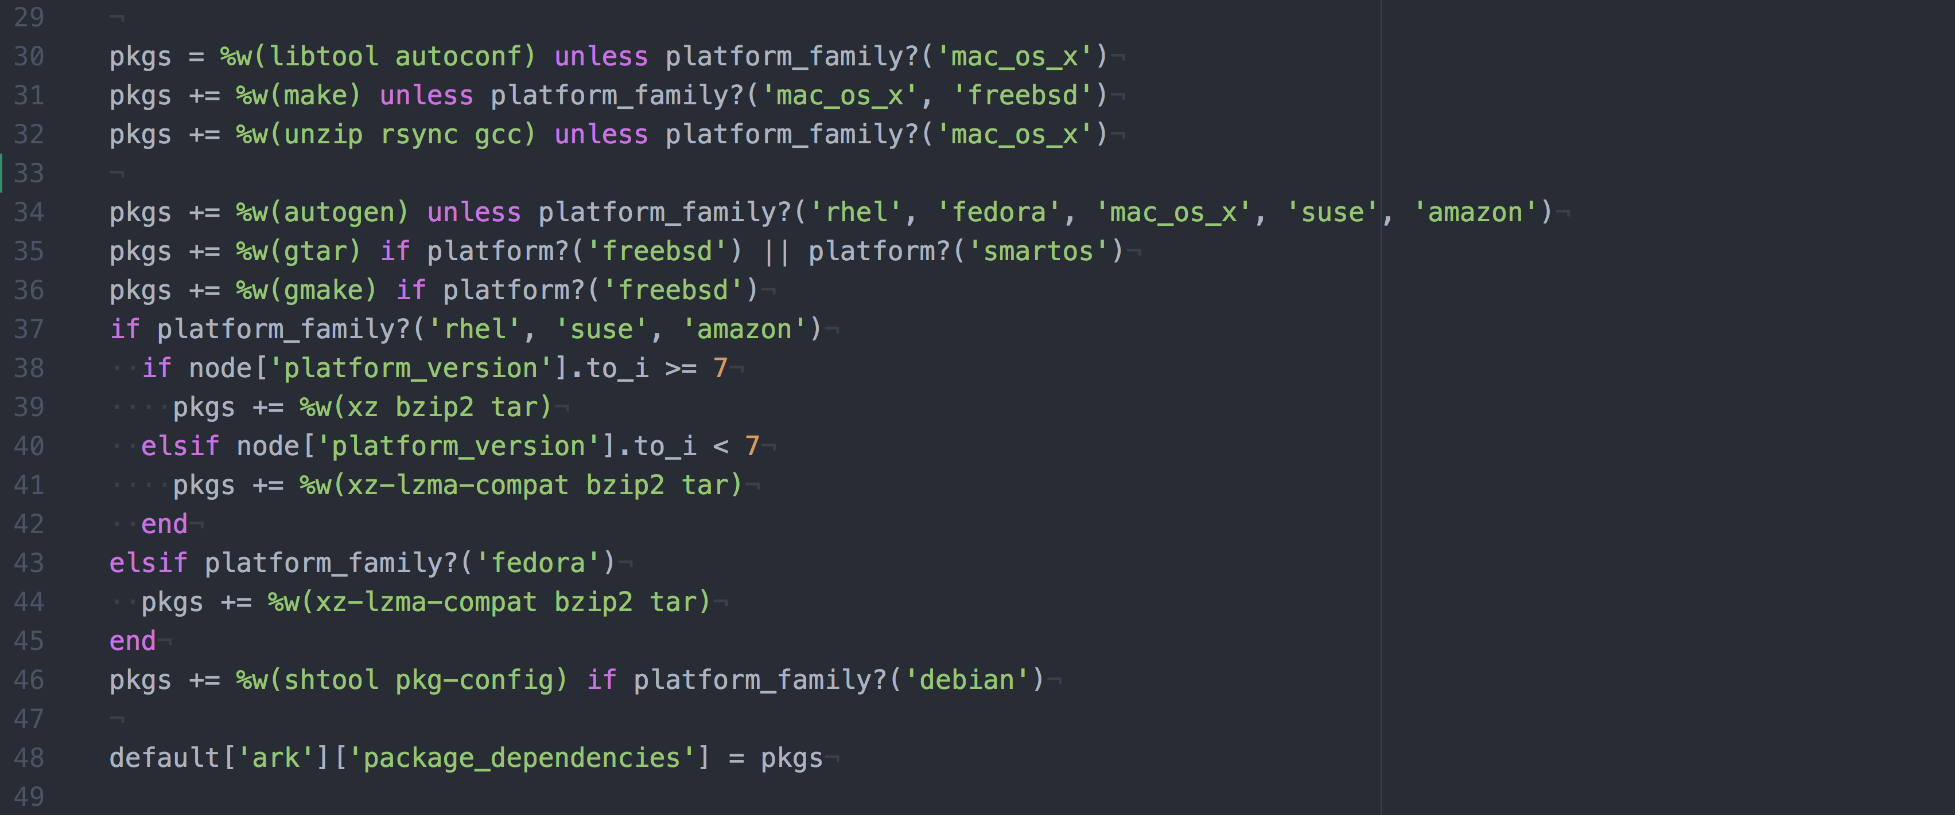
A Case for Writing Unit Tests
~/cookbooks/ark/attributes/default.rb
pkgs = %w(libtool autoconf) unless platform_family?('mac_os_x')
pkgs += %w(make) unless platform_family?('mac_os_x', 'freebsd')
pkgs += %w(unzip rsync gcc) unless platform_family?('mac_os_x')
pkgs += %w(autogen) unless platform_family?('rhel', 'fedora', 'mac_os_x', 'suse', 'amazon')
pkgs += %w(gtar) if platform?('freebsd') || platform?('smartos')
pkgs += %w(gmake) if platform?('freebsd')
# ... continues on the next slide ...

Slide 25
A Case for Writing Unit Tests
~/cookbooks/ark/attributes/default.rb
# ... continued from the next slide ...
if platform_family?('rhel', 'suse', 'amazon')
if node['platform_version'].to_i >= 7
pkgs += %w(xz bzip2 tar)
elsif node['platform_version'].to_i < 7
pkgs += %w(xz-lzma-compat bzip2 tar)
end
elsif platform_family?('fedora')
pkgs += %w(xz-lzma-compat bzip2 tar)
end
pkgs += %w(shtool pkg-config) if platform_family?('debian')
default['ark']['package_dependencies'] = pkgs

Slide 26
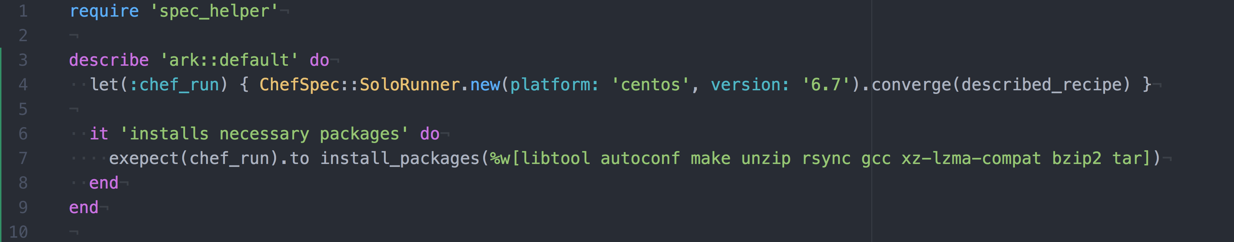
Is this 'Unit' Test Enough?
~/cookbooks/ark/spec/recipes/default_spec.rb

Slide 27
Is this 'Unit' Test Enough?
~/cookbooks/ark/spec/recipes/default_spec.rb
require 'spec_helper'
describe'ark::default' do
let(:chef_run) do
ChefSpec::SoloRunner.new(platform: 'centos', version: '6.7').converge(...
end
it 'installs core packages' do
expect(chef_run).to install_package(%w(libtool autoconf make unzip rsync gcc xz-lzma-compat bzip2 tar))
end
end

Slide 28



A Case for Writing Integration Tests
Changing Base Image Creation
Upgrading Platform Versions
Changing Physical to Virtual
Legacy Script/Tool
migrating
Updated Script/Tool
CentOS 6.7
migrating
CentOS 7.3
Physical / On Premise
migrating
Cloud / Virtual

Slide 29
‘Integration’ Test
‘Unit’ Test
Verify that the system has been configured correctly using InSpec through Test Kitchen.
Verify that the code has been written correctly using ChefSpec through RSpec.
cookbook
cookbook
attributes
attributes
resources
resources
custom resources
custom resources
libraries / helpers
libraries / helpers
System
System

Slide 30
Let's Answer These...
Why would I want to write tests? Doesn't Chef fail when there is a problem?
What is the difference between an integration test and a unit test?
Should I write unit tests or integration tests?

Slide 31
Agenda
Tell me more about Test Driven Development (TDD)
Writing and Executing an Integration Test
Writing and Executing a Unit Test
Further Resources

Slide 32
Writing and Executing an Integration Test
Create Test Instance
Install Chef
Apply the Run List
Build Node (ohai)
Synchronize Cookbooks
Build Resource Collection
Converge
Execute Tests

Slide 33
Writing and Executing an Integration Test
Learn about Test Kitchen's configuration and command-line interface
Learn about the InSpec language
Perform TDD with Test Kitchen and InSpec

Slide 34
Kitchen Configuration
When chef generates a cookbook a default .kitchen.yml is created or it can be created with the command kitchen init.
http://kitchen.ci/docs/getting-started/kitchen-yml
The configuration is stored in a file format called YAML.
http://yaml.org

Slide 35
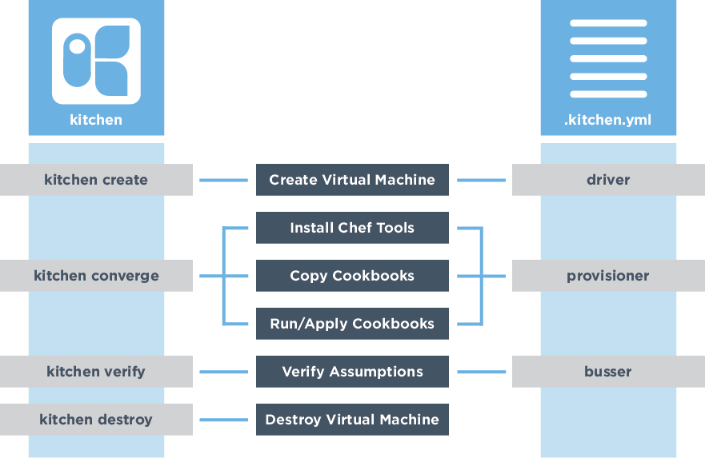
Test Kitchen's Configuration
Create Test Instance
Install Chef
Synchronize Cookbooks
Apply the Run List
Execute Tests

Slide 36
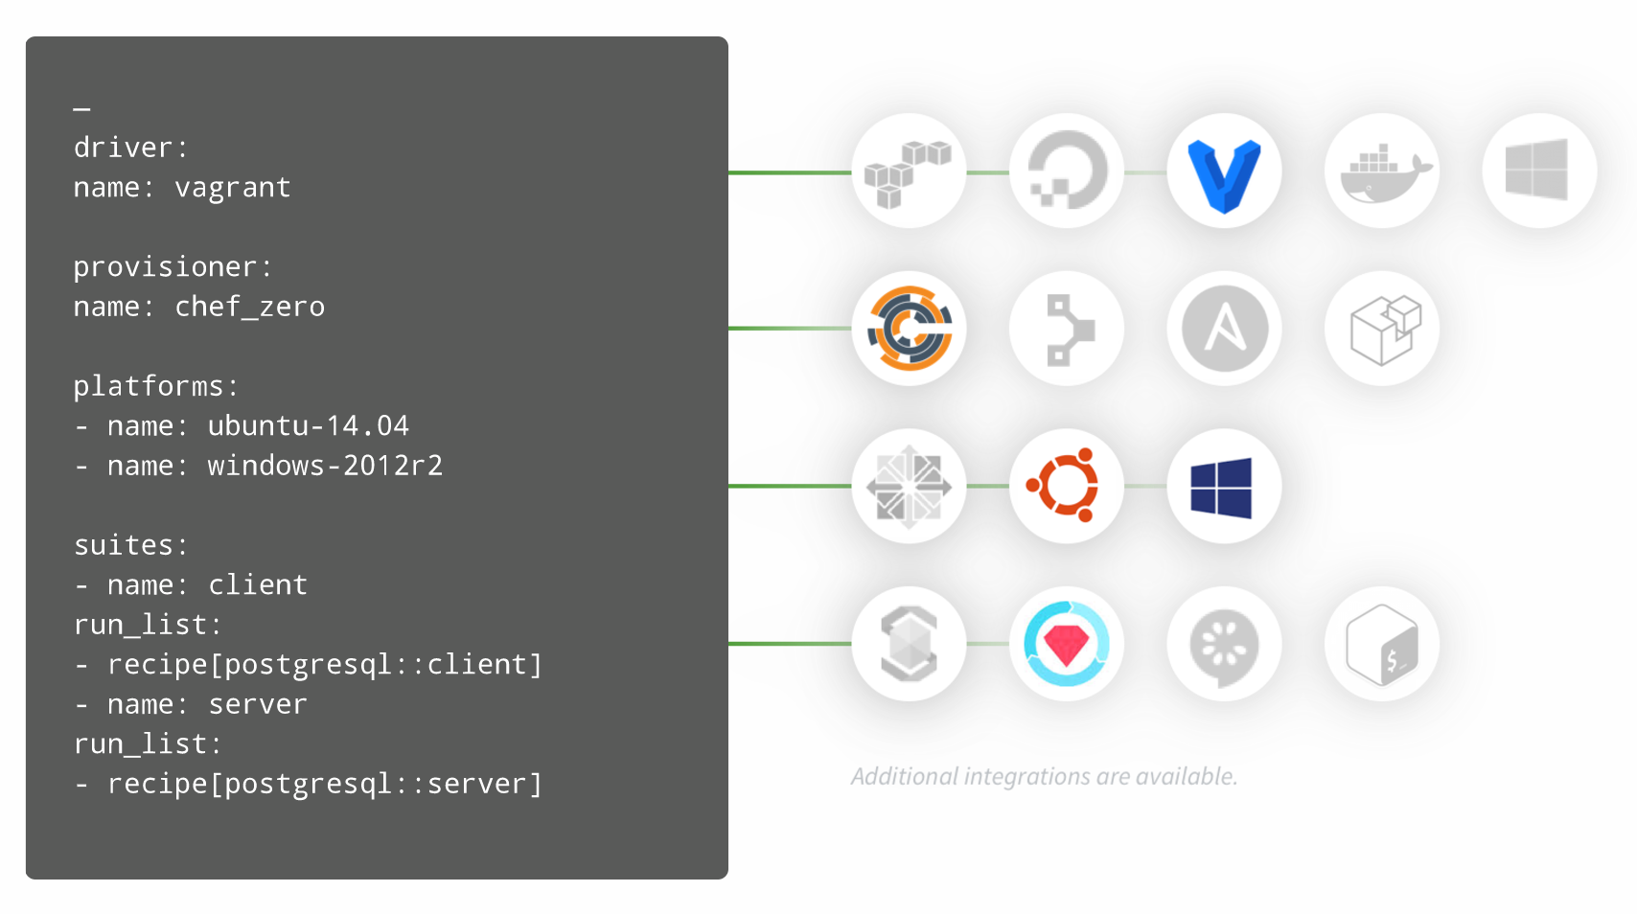

Test Kitchen's Configuration Makes it Versatile
kitchen.ci

Slide 37
Kitchen Platforms and Test Suites
~/cookbooks/users/.kitchen.yml
...
platforms:
- name: centos-6.7
suites:
- name: default
run_list:
- recipe[users::default]
verifier:
inspec_tests:
- test/smoke/default
attributes:
The list of platforms which you want to test against.
The suites section defines a list of suites which define the run list and tests we want to execute.
Notes:
This default suite will execute the run list containing: The workstation cookbook's default recipe.

Slide 38
Your Test Matrix
Kitchen defines a list of instances, or test matrix, based on the platforms multiplied by the suites.
PLATFORMS x SUITES
Running kitchen list will show that matrix.

Slide 39
View the Test Matrix for Test Kitchen
$ kitchen list
Instance Driver Provisioner Verifier Transport Last Action
default-centos-67 Vagrant ChefZero InSpec Ssh <Not Created>

Slide 40
Where Are the Tests Stored
~/cookbooks/users/.kitchen.yml
...
platforms:
- name: centos-6.7
suites:
- name: default
run_list:
- recipe[users::default]
verifier:
inspec_tests:
- test/smoke/default
attributes:
The location which to find the InSpec tests.
Notes:
This default suite will execute the run list containing: The workstation cookbook's default recipe.

Slide 41
Test Kitchen's Commands
Create Test Instance
Install Chef
Synchronize Cookbooks
Apply the Run List
Execute Tests

Slide 42
Create the Test Instance
$ kitchen create
-----> Starting Kitchen (v1.11.1)
-----> Creating <default-centos-67>...
Sending build context to Docker daemon 193 kB
Sending build context to Docker daemon
Step 0 : FROM centos:centos6
centos6: Pulling from centos
3690474eb5b4: Pulling fs layer
c12ea02d7eb2: Pulling fs layer
334af8693ca8: Verifying Checksum
334af8693ca8: Download complete
273a1eca2d3a: Verifying Checksum
Notes:
Create the instance with the following command. Here Test Kitchen will ask the driver specified in the kitchen configuration file to provision an instance for us.

Slide 43
Converge the Virtual Instance
$ kitchen converge
----> Starting Kitchen (v1.11.1)
-----> Converging <default-centos-67>...
$$$$$$ Running legacy converge for 'Docker' Driver
...
-----> Installing Chef Omnibus (install only if missing)
Downloading https://www.chef.io/chef/install.sh to file...
resolving cookbooks for run list: ["httpd::default"]
...
Finished converging <default-centos-67> (0m27.64s).
-----> Kitchen is finished. (0m28.58s)
Notes:
Creating the instance allows us to view the operating system but Chef is not installed and the cookbook recipe, defined in the run list of the default test suite, has not been applied to the system. To do that you need to run 'kitchen converge'. Converge will take care of all of that.
In this instance the default recipe of the httpd cookbook contains no resources. You have not written a single resource that defines your desired state. Before we do that we want to ensure the instance is not already in a state that perhaps already meets the expectations that we defined.

Slide 44
Execute the Tests Against the Virtual Instance
$ kitchen verify
-----> Starting Kitchen (v1.11.1)
-----> Setting up <default-centos-67>...
-----> Verifying <default-centos-67>...
Use `/home/chef/httpd/test/smoke/default` for testing
Target: ssh://kitchen@localhost:32768
✖ Port 80 should be listening (expected `Port 80.listening?...
✖ Command curl localhost stdout should match /Hello, world/...
Notes:
To verify the state of the instance with specification that we defined we use the 'kitchen verify' command. This command will install all the necessary testing tools, configure them, and then execute the test suite, and return to us the results.
Something that is important to mention is that we could have simply run this command from the start. When no previous instance exists, no instance has been created or converged, this command will automatically perform those two steps. When the instance is running, however, the verification step is only run.

Slide 45
Understanding the Failure Message
Target: ssh://kitchen@localhost:32768
✖ Port 80 should be listening (expected `Port 80.listening?` to return true, got false)
✖ Command curl localhost stdout should match /Welcome Home/ (expected "" to match /Welcome Home/
Diff:
@@ -1,2 +1,2 @@
-/Welcome Home/
+""
)
Summary: 0 successful, 2 failures, 0 skipped
>>>>>> ------Exception-------
>>>>>> Class: Kitchen::ActionFailed
>>>>>> Message: 1 actions failed.
>>>>>> Verify failed on instance <default-centos-67>. Please see .kitchen/logs/defau...
Notes:
Now, let's read the results from the kitchen verification to ensure that our expectations failed to be met.

Slide 46
Examine Failure #1
✖ Port 80 should be listening (expected `Port 80.listening?` to return true, got false)
✖ Command curl localhost stdout should match /Welcome Home/ (expected "" to match /Welcome Home/
Diff:
@@ -1,2 +1,2 @@
-/Welcome Home/
+""
)
actual results
difference
Notes:
Each failure is displayed with a human-readable sentence about the defined resource, the expected results, and the result that was received (or 'got').
We see that we have two errors. The first is that port 80 is not listening when we expected to be listening. We also expected the command's standard out to return content to us and it did not; it returned nothing.

Slide 47
Examine the Test Summary
✖ Port 80 should be listening (expected `Port 80.listening?` to return true, got false)
✖ Command curl localhost stdout should match /Welcome Home/ (expected "" to match /Welcome Home/
Diff:
@@ -1,2 +1,2 @@
-/Welcome Home/
+""
)
Summary: 0 successful, 2 failures, 0 skipped
A final summary contains the length of execution time with the results shows that InSpec verified 2 examples and found 2 failures.
Notes:
After all the failures a final summary of the results will be displayed which shows us that our test suite contains 2 examples and that 2 examples failed to meet expectations.

Slide 48
Kitchen Converge & Verify
Running converge or verify will create a new instance the first time it is run. The same instance is used for each additional converge or verify.
When making a change to the recipes use:
When making a change to the tests use:
$ kitchen converge && kitchen verify
$ kitchen verify
Notes:
This is important feature and limitation of using Test Kitchen's 'converge' and 'verify'. Both of these commands will create a test instance the first time they are executed. Every time after these commands will use the same test instance again and again.
When we remove resources from a recipe we do not explicitly uninstall them from the test instance. We simply do not enforce their policy anymore. On an existing system, which this test instance is after the first run, this means it is actually in the desired state that we no longer define. That means that the webserver is still installed, the default web page has still been updated, and the service is still running.
To ensure our cookbook works on a new system it is important to delete the test instance and start over.

Slide 49
Kitchen Test
$ kitchen test [INSTANCE|REGEXP|all]
Destroys (for clean-up), creates, converges, verifies
and then destroys one or more instances.
Notes:
Test Kitchen also provides the subcommand 'test'. Test provides one command that wraps up all the stages in one command. It will destroy any test instance that exists at the start, create a new one, converge the run list on that instance, and the verify it. If everything passes the 'test' subcommand will finish by destroying that instance. If it fails at one of these steps it usually leaves the instance running to allow you to troubleshoot it.
Instructor Note: It works as all the other commands do with regard to parameters and targeting instances.

Slide 50
Kitchen Test
$ kitchen test [INSTANCE|REGEXP|all]
Create Test Instance
Install Chef
Sync Cookbooks
Apply the Run List
Execute Tests
Destroy
Create Test Instance
Install Chef
Sync Cookbooks
Apply the Run List
Execute Tests
Destroy
Notes:
Test Kitchen also provides the subcommand 'test'. Test provides one command that wraps up all the stages in one command. It will destroy any test instance that exists at the start, create a new one, converge the run list on that instance, and the verify it. If everything passes the 'test' subcommand will finish by destroying that instance. If it fails at one of these steps it usually leaves the instance running to allow you to troubleshoot it.
Instructor Note: It works as all the other commands do with regard to parameters and targeting instances.

Slide 51
Kitchen Test
Destroying the instance ensures that the policy is being applied to a new instance.
Before committing your changes run:
$ kitchen test
Notes:
Running 'kitchen test' is useful if want to ensure the policy you defined works on a new instance.

Slide 52
Converge & Verify
Test
Faster execution time
Running converge twice will ensure your policy applies without error to existing instances
Slower execution time
Running test will ensure your policy applies without error to any new instances
Notes:
Using Test Kitchen to run 'kitchen converge' and 'kitchen verify' is much faster because you are essentially applying and verifying the policy that you have defined against an already running instance. The drawback is that only running 'converge' and 'verify' will not demonstrate for you how your policy will act on a brand new instance.
Using Test Kitchen to run 'kitchen test' is slower because every time you are recreating the test instance, installing chef, and applying the policy on that new instance. The drawback here is the longer feedback cycle and only running 'test' will not demonstrate for you how your policy will act on an existing instance.

Slide 53
Test Kitchen's Commands and Configuration
Create Test Instance
Install Chef
Synchronize Cookbooks
Apply the Run List
Execute Tests

Slide 54
Writing and Executing an Integration Test
Learn about Test Kitchen's configuration and command-line interface
Learn about the InSpec language
Perform TDD with Test Kitchen and InSpec

Slide 55


extends RSpec
RSpec is a Domain Specific Language (DSL) that allows you to express and execute expectations. These expectations are expressed in examples that are asserted in different example groups.
InSpec provides helpers and tools that allow you to express expectations about the state of infrastructure.
RSpec
Ruby
inspec.io
Notes:
RSpec is a Behavior Driven Development (BDD) framework that uses a natural language domain-specific language (DSL) to quickly describe scenarios in which systems are being tested. RSpec allows you to setup a scenario, execute the scenario, and then define expectations on the results. These expectations are expressed in examples that are asserted in different example groups.
RSpec by itself grants us the framework, language, and tools. InSpec provides the knowledge about expressing expectations about the state of infrastructure.

Slide 56
InSpec's Resources
InSpec provides 87 resources to help you express the state of your system.
aide_conf, apache_conf, apt, audit_policy, auditd_conf, auditd_rules, bash, bond, bridge, bsd_service, command, crontab, csv, directory, docker, docker_container, docker_image, etc_group, etc_hosts, file, gem, group, grub_conf, host, http, iis_app, iis_site, inetd_conf, ini, interface, iptables, json, kernel_module, kernel_parameter, key_rsa, launchd_service, limits_conf, login_def, mount, mssql_session, mysql_conf, mysql_session, npm, ntp_conf, oneget, oracledb_session, os, os_env, package, parse_config, parse_config_file, passwd, pip, port, postgres_conf, postgres_hba_conf, postgres_ident_conf, postgres_session, powershell, processes, rabbitmq_config, registry_key, runit_service, security_policy, service, shadow, ssh_config, sshd_config, ssl, sys_info, systemd_service, sysv_service, upstart_service, user, users, vbscript, virtualization, windows_feature, windows_task, wmi, x509_certificate, xinetd_conf, xml, yaml, yum, zfs_dataset, zfs_poo
inspec.io/docs/reference/resources

Slide 57
Components of a InSpec Example
OS conditional
unless os.windows?
describe user('root'), :skip do
it { should exist }
end
end
InSpec resource
expectation
When not on Windows, I expect the user named 'root', to exist.
Notes:
The outermost statement is a conditional that states that when we want to evaluate the contents in between when we are not on Windows (e.g. CentOS, Ubuntu, Debian).
The inner describe has two parameters: The first is the the user resource named 'root' on the test instance. The second is the block which contains the expectations that we want to assert for the given resource.
Within the block we can define any number of expectations about the particular resource in the description. In this instance we are saying that we expect the user, named 'root', to exist on the instance. After the expectation that has been defined is a skip. This skip is a reminder that the examples have been defined in this test file were automatically generated and should be updated or removed.

Slide 58
Components of a InSpec Example
describe port(80) do
it { should_not be_listening }
end
InSpec resource
expectation
When on any platform, I expect the port 80 not to be listening for incoming connections.
Notes:
The second example within the test file describes the port 80 on any operating system and states the expectation that it does not expect port 80 to be listening.
By default all operating systems will be examined. So this example would be evaluated and executed against every operating system.

Slide 59
Writing and Executing an Integration Test
Learn about Test Kitchen's configuration and command-line interface
Learn about the InSpec language
Perform TDD with Test Kitchen and InSpec

Slide 60
Docker
I have the following versions of software installed on my system:
Test Kitchen
Docker CLI
kitchen-docker gem
1.17.0 (Chef DK 2.3.4)
17.09.0-ce-rc3
2.6.0

Slide 61
Vagrant and Virtual Box Versions
I have the following versions of software installed on my system:
Test Kitchen
Vagrant
Virtual Box
Virtual Box Extensions Pack
1.17.0 (Chef DK 2.3.4)
2.0.0
5.1.26
5.1.26

Slide 62
Test Driven Development
1
Define a test that expresses the desired state
2
Implement the solution
3
Verify that the implementation meets the desired state
4
Refactor
Notes:
Test Driven Development (TDD) is a workflow that asks you to perform that act continually and repeatedly as you satisfy the requirements of the work you have chosen to perform.
TDD generically focuses on the unit of software any level. It is the process of writing the test first, implementing the unit, and then verifying the implementation with the test that was written.
A 'unit' of software is purposefully vague. This 'unit' is definable by the individuals developing the software. So the size of a 'unit of software' likely has different meanings to different individuals based on our backgrounds and experiences.

Slide 63
Writing and Executing an Integration Test
Learn about Test Kitchen's configuration and command-line interface
Learn about the InSpec language
Perform TDD with Test Kitchen and InSpec

Slide 64
Agenda
Tell me more about Test Driven Development (TDD)
Writing and Executing an Integration Test
Writing and Executing a Unit Test
Further Resources

Slide 65
Writing and Executing a Unit Test
Create Test Instance
Install Chef
Apply the Run List
Build Node (ohai)
Synchronize Cookbooks
ChefSpec
Build Resource Collection
Converge
RSpec
Execute Tests

Slide 66
Resource Collection
httpd
default
Resource Collection
install
package 'httpd'
configuration
file '/var/w...
service
service 'httpd'
Notes:
But first let's talk more about the 'Resource Collection' ...
After a cookbook and its recipes have been synchronized the majority of the cookbook content is loaded into memory by 'chef-client'. The recipes defined on the run list are evaluated during this time and the resources found within the recipes and any included recipes, are added to a resource collection. They are not immediately executed like one might assume.
The 'Resource Collection' is almost like a to-do list for the node. It contains the list of all the resources, in order, that need to be accomplished to bring the instance into the desired state. Later, in the converge step, the resources defined in the Resource Collection are executed and perform their various forms of test-and-repair to bring the instance into the desired state.

Slide 67
Writing and Executing a Unit Test
Learn about RSpec's configuration and command-line interface
Learn about the ChefSpec language
Perform TDD with RSpec and ChefSpec

Slide 68
RSpec's Default Conventions
RSpec expects all tests to be defined in a sub-directory named spec.
All test files need to end with _spec.rb.
spec
├── spec_helper.rb
└── unit
└── recipes
└── default_spec.rb

Slide 69
RSpec Displays Results in Progress Format
$ chef exec rspec
...*..**........FFFFFFFFF..FFF..
`.` represents a passing example
`F` represents a failing examples
`*` represents a pending example

Slide 70
RSpec Displays Results in Progress Format
$ chef exec rspec
Failures:
1) ark::default sets default attributes prefix root
Failure/Error: expect(chef_run.node["ark"]["prefix_root"])...
expected: "/usr/local"
got: "/usr/l ocal"
(compared using ==)
# ./spec/recipes/default_spec.rb:30:in `block (3 levels)...

Slide 71
Failures Display Expected and What it Got
$ chef exec rspec
Failures:
1) ark::default sets default attributes prefix root
Failure/Error: expect(chef_run.node["ark"]["prefix_root"])...
expected: "/usr/local"
got: "/usr/l ocal"
(compared using ==)
# ./spec/recipes/default_spec.rb:30:in `block (3 levels)...

Slide 72
Failures Display the Location of the Failure
$ chef exec rspec
Failures:
1) ark::default sets default attributes prefix root
Failure/Error: expect(chef_run.node["ark"]["prefix_root"])...
expected: "/usr/local"
got: "/usr/l ocal"
(compared using ==)
# ./spec/recipes/default_spec.rb:30:in `block (3 levels)...

Slide 73
RSpec Displays a Results Summary
$ chef exec rspec
expected: "/usr/local"
got: "/usr/l ocal"
(compared using ==)
# ./spec/recipes/default_spec.rb:30:in `block (3 levels)...
Finished in 1.71 seconds (files took 1.98 seconds to load)
82 examples, 1 failure

Slide 74
RSpec Displays a Results Summary
$ chef exec rspec
expected: "/usr/local"
got: "/usr/l ocal"
(compared using ==)
# ./spec/recipes/default_spec.rb:30:in `block (3 levels)...
Finished in 1.71 seconds (files took 1.98 seconds to load)
82 examples, 1 failure

Slide 75
Command to Execute Individual Example
$ chef exec rspec
Finished in 1.71 seconds (files took 1.98 seconds to load)
82 examples, 1 failure
Failed examples:
rspec ./spec/unit/default_spec.rb:29 # ark::default sets defaul...

Slide 76
Command to Execute Individual Example
$ chef exec rspec --color -f documentation
Ark::ProviderHelpers
#owner_command
when on windows
generates a icacls command
when not on windows
...

Slide 77
Writing and Executing a Unit Test
Learn about RSpec's configuration and command-line interface
Learn about the ChefSpec language
Perform TDD with RSpec and ChefSpec

Slide 78
extends RSpec
ChefSpec
RSpec is a Domain Specific Language (DSL) that allows you to express and execute expectations. These expectations are expressed in examples that are asserted in different example groups.
ChefSpec provides helpers and tools that allow you to express expectations about the state of resource collection.
ChefSpec
RSpec
Ruby
Notes:
RSpec is a Behavior Driven Development (BDD) framework that uses a natural language domain-specific language (DSL) to quickly describe scenarios in which systems are being tested. RSpec allows you to setup a scenario, execute the scenario, and then define expectations on the results. These expectations are expressed in examples that are asserted in different example groups.
RSpec by itself grants us the framework, language, and tools. InSpec provides the knowledge about expressing expectations about the state of infrastructure.

Slide 79
ChefSpec's Matchers
InSpec provides matchers for all the default resources and cookbook's with custom resources can also provide their own custom matchers.
github.com/chefspec/chefspec

Slide 80
View the Test for the Default Recipe
~/httpd/spec/unit/recipes/default_spec.rb
example groups
require 'spec_helper'
describe 'httpd::default' do
context 'When all attributes are default, on an unspecified platform' do
let(:chef_run) do
runner = ChefSpec::ServerRunner.new
runner.converge(described_recipe)
end
it 'converges successfully' do
expect { chef_run }.to_not raise_error
end
end
end
cookbook name::recipe name
Notes:
It is often common for specification files to share similar functionality. As your suite of examples grows you will often move common, shared expectations and helpers to a common file that is required here at the top of the file. This will load the contents of the 'spec_helper' file found within the root of the 'spec' directory.
ChefSpec employs RSpec's example groups to describe the cookbook's recipe. This is stating that the examples we defined within this outer example group all relate to the httpd cookbook's default recipe. Within this example group we see another context that is defined. This time using the method 'context'. 'context' and 'describe' are exactly same in almost every way. A lot of developers like to use context as it more clearly states that the example group is focused on a particular scenario. In this instance the particular scenario we are going to be specifying examples in a scenario where all the attributes are default on an unspecified platform.
Instructor Note: 'describe' and 'context' are almost completely interchangeable with one exception. 'context' cannot be used as the outermost example group.

Slide 81
View the Test for the Default Recipe
~/httpd/spec/unit/recipes/default_spec.rb
require 'spec_helper'
describe 'httpd::default' do
context 'When all attributes are default, on an unspecified platform' do
let(:chef_run) do
runner = ChefSpec::ServerRunner.new
runner.converge(described_recipe)
end
it 'converges successfully' do
expect { chef_run }.to_not raise_error
end
end
end
example
expectation
Notes:
Within the inner context we finally set the stage for us to define our examples with their expectations. There is a single example defined and that is stating that when the chef run evaluates and creates the resource collection it should do so without raising an error. A situation that might raise an error is if we included a recipe that does not exist or if we were to use a resources type that does not exist.

Slide 82
View the Test for the Default Recipe
~/httpd/spec/unit/recipes/default_spec.rb
described recipe
require 'spec_helper'
describe 'httpd::default' do
context 'When all attributes are default, on an unspecified platform' do
let(:chef_run) do
runner = ChefSpec::ServerRunner.new
runner.converge(described_recipe)
end
it 'converges successfully' do
expect { chef_run }.to_not raise_error
end
end
end
Ruby Class
chef_run helper
Notes:
The 'chef_run' helper there is being provided by the 'let' defined above the example within the same context. Defining the 'chef_run' in the 'let' above is done with a Ruby Symbol. This is simply naming it so that it can be used within any of the examples in the current context and even sub-contexts. The helper is simply executing some code that sets up an in-memory chef-client run with a Chef Server.
The 'ServerRunner' is a class defined within the 'ChefSpec' namespace. All Ruby classes have the method 'new' which will return an object which is a new instance of that described class. The object is stored in a local variable, named 'runner', which immediately invokes a method 'converge' with a single parameter 'described_recipe'
The parameter 'described_recipe' refers to the recipe defined in the outermost describe. This is mostly for convenience so that we do not have to redefine the same String multiple times within the same specification file.
The goal of this single, boilerplate example is very simple: perform a chef-client run and ensure there are no errors. Now, let's execute this specification.

Slide 83
Testing a Resource That Takes Action
~/httpd/recipes/default.rb
package 'httpd' do
action :install
end
~/httpd/spec/unit/recipes/default_spec.rb
it 'installs the necessary packages' do
expect(chef_run).to install_package('httpd')
end
action
_
resource
(
name
)

Slide 84
Writing and Executing a Unit Test
Learn about RSpec's configuration and command-line interface
Learn about the ChefSpec language
Perform TDD with RSpec and ChefSpec

Slide 85
ChefSpec and RSpec
These tools are all packaged in the Chef Development Kit:
Chef DK
chefspec gem
rspec gem
fauxhai
2.3.4
7.1.0
3.6.0
5.3.0

Slide 86
Ruby Already Installed?
If you already have Ruby installed you should run:
Prefacing the command here ensures that you are using the version packaged with the installed Chef Development Kit.
$ chef exec rspec

Slide 87
Test Driven Development
1
Define a test that expresses the desired state
2
Implement the solution
3
Verify that the implementation meets the desired state
4
Refactor
Notes:
Test Driven Development (TDD) is a workflow that asks you to perform that act continually and repeatedly as you satisfy the requirements of the work you have chosen to perform.
TDD generically focuses on the unit of software any level. It is the process of writing the test first, implementing the unit, and then verifying the implementation with the test that was written.
A 'unit' of software is purposefully vague. This 'unit' is definable by the individuals developing the software. So the size of a 'unit of software' likely has different meanings to different individuals based on our backgrounds and experiences.

Slide 88
Writing and Executing a Unit Test
Learn about RSpec's configuration and command-line interface
Learn about the ChefSpec language
Perform TDD with RSpec and ChefSpec

Slide 89
Agenda
Tell me more about Test Driven Development (TDD)
Writing and Executing an Integration Test
Writing and Executing a Unit Test
Further Resources

Slide 90

Real Examples of Testing
The Joy of Automating is an hour long instructional episode. Each episode focuses on building cookbooks or adding features to an existing cookbook while sharing techniques on workflow, testing, and debugging.
YouTube: https://goo.gl/ZMmSnj

Slide 91

Improving Your Workflow
Configuring your text editor
Combining integration tests and unit tests into a single command with Rake
Executing tests on file changes with Guard
Debugging your cookbooks with Pry
YouTube: https://goo.gl/KuCSFR

Slide 92

Explore RSpec's Testing Language
Exploring RSpec's Helpers
Create common helpers
Removing redundancies in a test suite
Extract helpers into a portable library
YouTube: https://goo.gl/REo86v

Slide 93
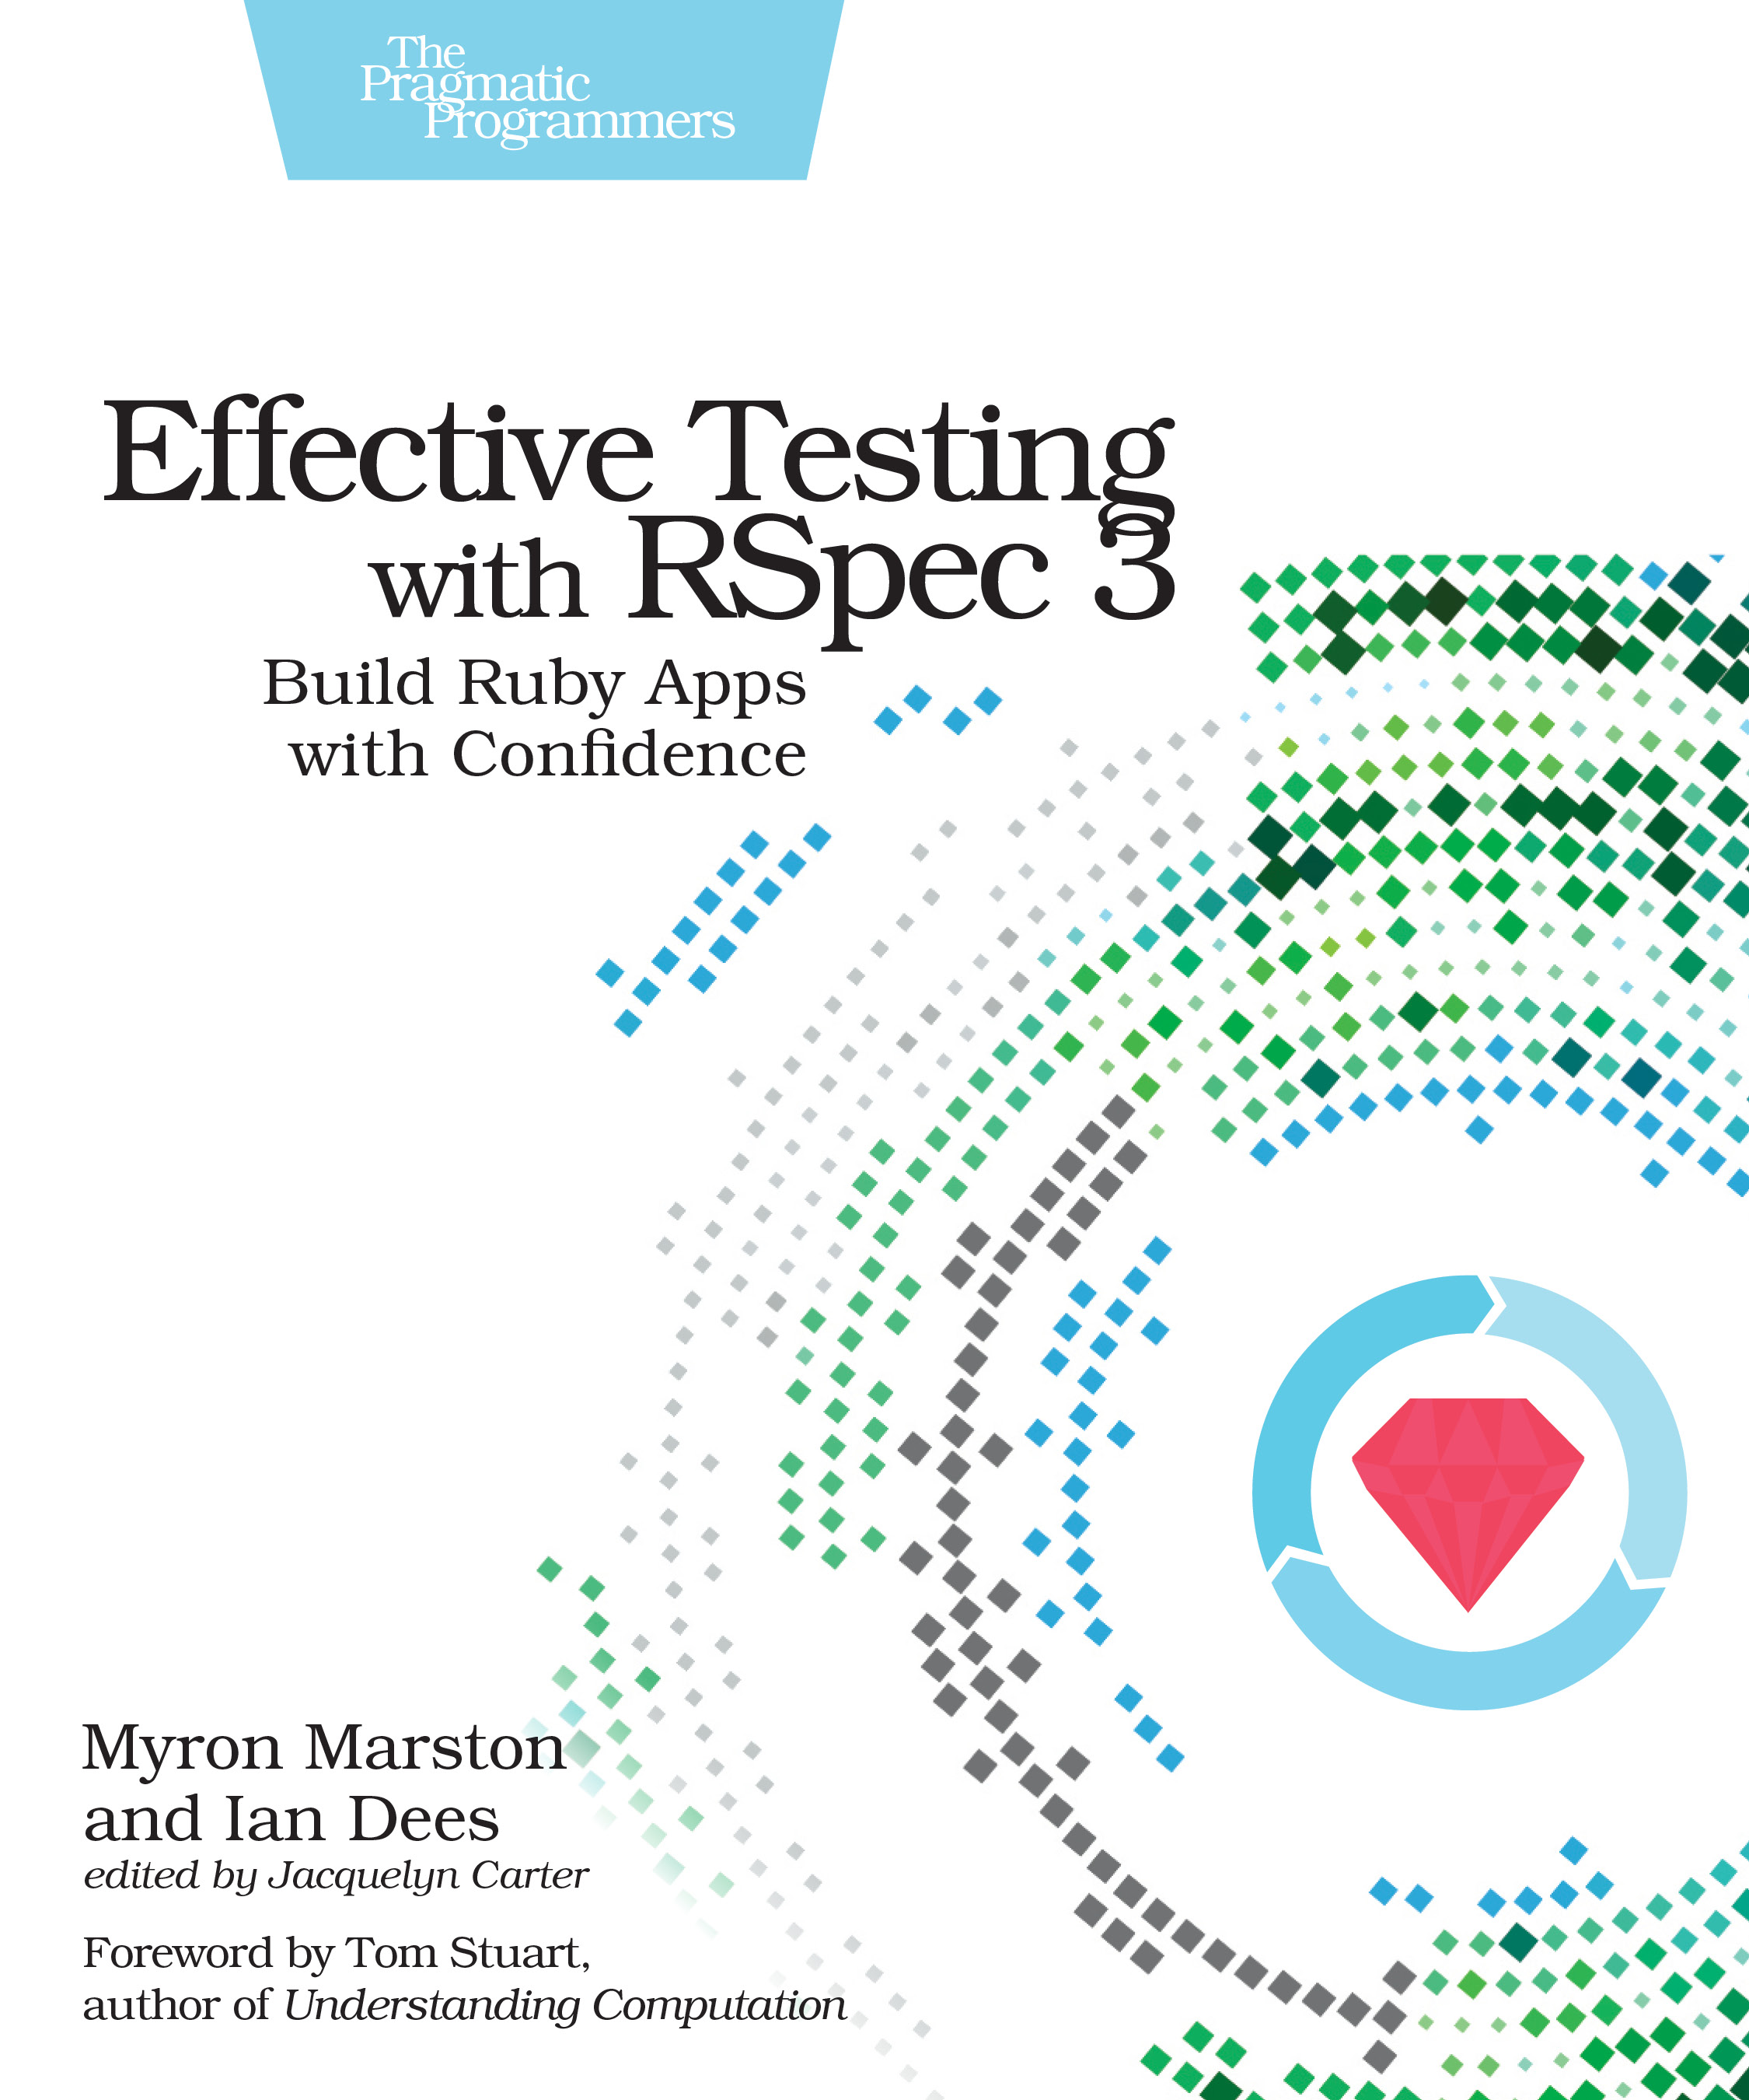
Learn More About RSpec
This definitive guide from RSpec’s lead developer shows you how to use RSpec to drive more maintainable designs, specify and document expected behavior, and prevent regressions during refactoring.
Pragmatic Bookshelf: https://goo.gl/Bbp3CF

Slide 94
Agenda
Tell me more about Test Driven Development (TDD)
Writing and Executing an Integration Test
Writing and Executing a Unit Test
Further Resources

